Slide 1

Project Report on Smart Highway Using 8051 Microcontroller
Central University of Haryana , Mahendergarh
Submitted in partial fulfilment of the requirements of the degree of
Bachelor of Technology in Electrical Engineering
Submitted to
Dr. Manish Kumar , Assistant Professor
Department of Electrical Engineering
Submitted By
Atul Pandey( 180915)
Ravikant prasad(180933)
Sanjay raj (180937)
Siddharth Sharma (180942)

Slide 2

Table of Contents
Lecture Review
Introduction
Wind energy
Solar cell
Block diagram

Slide 3
Hardware specification
AT9S52 microcontroller & Interfacing seven segment display to 8051
Block diagram representation of embedded system programming
References

Slide 4
Lecture Review
The project aims at saving energy by detecting the vehicle movement on highways and switching on the block of street light ahead of it and simultaneously switching off the trailing lights. The project requires sensors to detect the vehicle movements and switches on the lights ahead of it. As soon as the vehicle moves ahead the trailing lights automatically switches off. This can be used to save a lot of energy instead of using conventional system where the street lights are remained ON.
This proposed system provides a solution for energy saving. This is achieved by sensing an approaching vehicle and then switches ON a block of street lights ahead of the vehicle. As the vehicle passes by, the trailing lights switch OFF automatically. Thus, we save a lot of energy. So when there are no vehicles on the highway , Sensors used on either side of the road senses vehicle movement and sends logic commands to microcontroller to switch ON/OFF the LEDs. Thus this way of dynamically changing intensity ON/OFF helps in saving a lot of energy. The sensors sense the vehicle movements and send it to a 8051 family microcontroller that initiates commands for switching the lights ON/OFF.

Slide 5
Introduction
During last few decades, electrical energy is the basic requirement of human beings. The ratio of electricity requirement is increasing day by day. But we know that the resources for power generation are limited, and this has caused the energy crisis. The increasing power demand results reduce in conventional resources for power generation and increase the pollutants emissions. In order to minimize the emission of greenhouse gases, renewable energy technologies are widely used for electricity generation. Solar and wind technologies are frequently used for electricity generation.

Slide 6

Wind Energy
Wind energy is the converting of wind power to electrical power through the use of windmills or turbines. electricity produced is sent to transformers where voltage is increased and sent to the power grid via transmission lines.
WINDMILL DESIGN
A Windmill captures wind energy and then uses a generator to convert it to electrical energy.
The design of a windmill is an integral part of how efficient it will be.

Slide 7
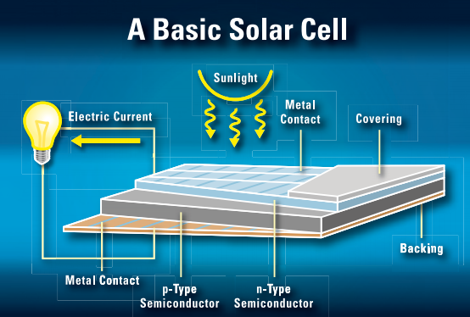
Solar cell
A single simple solar cell makes only a little electricity. For most purposes more is needed. For this reason, cells are often linked together in groups known as solar modules. A solar module has a frame that holds the cells. Some modules are several feet long and wide. They usually can produce up to a few hundred watts of electricity. If more power is needed, modules can be joined together to form a large solar array.

Slide 8
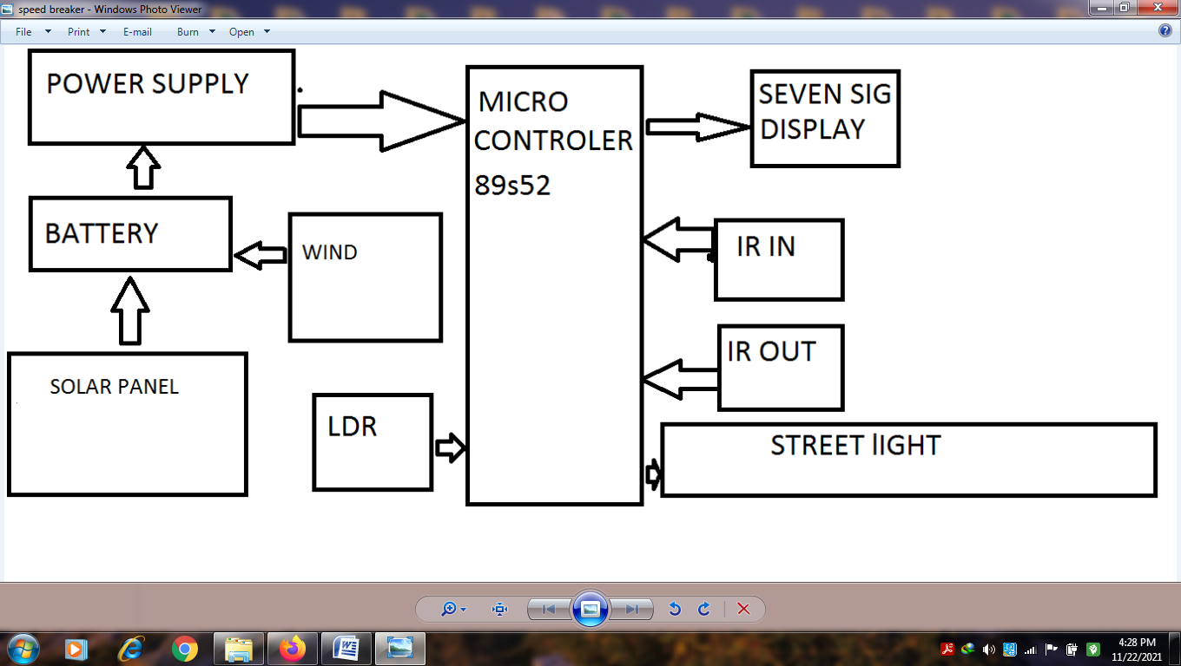
Block Diagram

Slide 9
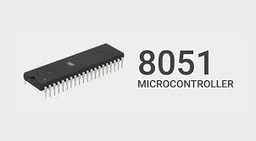
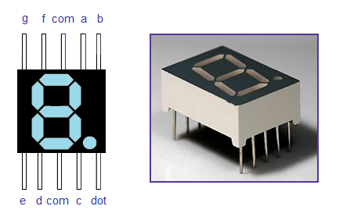
Hardware Specifications
8051 microcontroller is an 8-bit microcontroller. It is built with 40 pins DIP (dual inline package), 4kb of ROM storage and 128 bytes of RAM storage, (2)6-bit timers. It consists of four parallel 8-bit ports, which are programmable as well as addressable as per the requirement.
8051 series Microcontroller
A seven-segment display is a form of electronic display device for displaying decimal numerals that is an alternative to the more complex dot matrix displays. Seven-segment displays are widely used in digital clocks, electronic meters, basic calculators, and other electronic devices that display numerical information.
7- Segment Displays

Slide 10
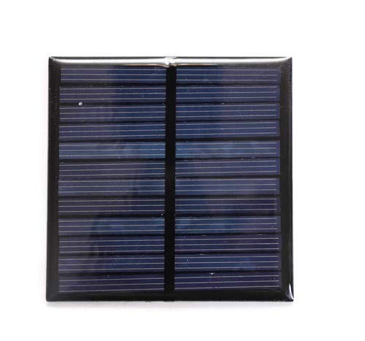
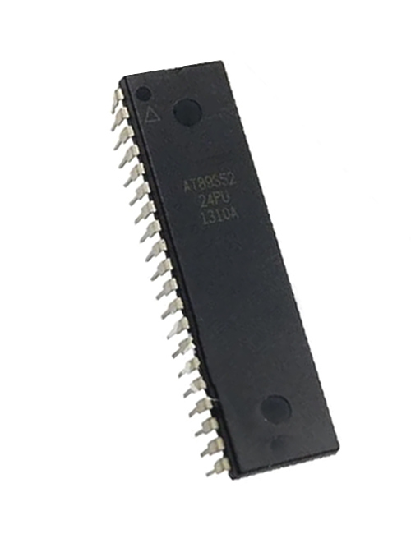
A solar cell panel is an assembly of photo-voltaic cells mounted in a framework for installation. Solar panels use sunlight as a source of energy to generate direct current electricity.
The AT89S52 comes from the popular 8051 family of Atmel Microcontrollers. It is an 8-bit CMOS microcontroller with 8K as Flash memory and 256 bytes of RAM. Since it is similar to the trust worthy 8051 architecture these microcontrollers are as per industry standard. It has 32 I/O pins comprising of three 16-bit timers, external interrupts, full-duplex serial port, on-chip oscillator and clock circuitry.

Slide 11
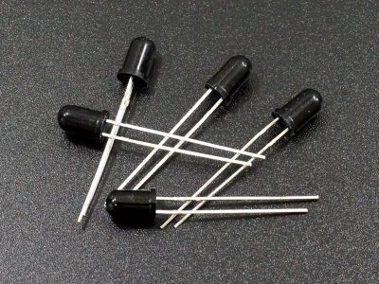
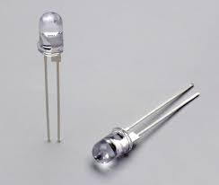
Other Accessories
IR receiver
IR led
DC motor

Slide 12
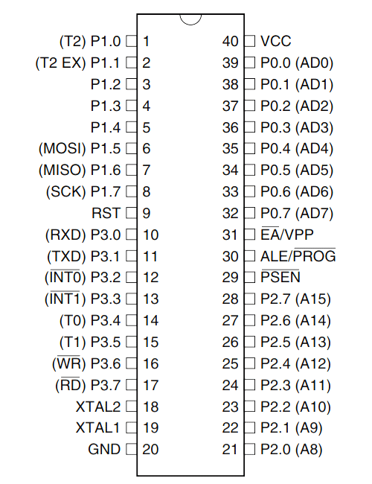
Pin Diagram OF AT9S52 microcontroller

Slide 13
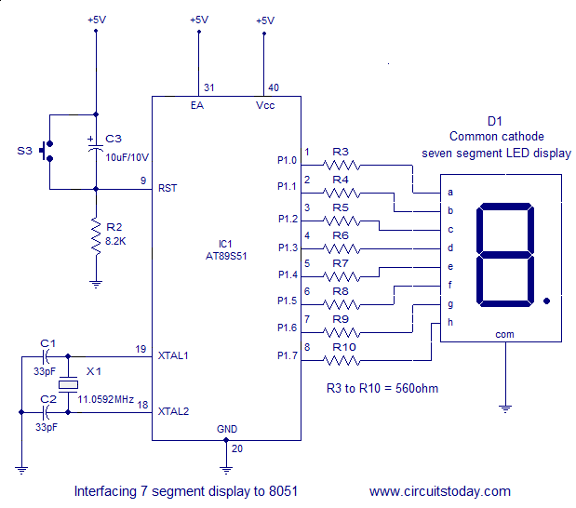
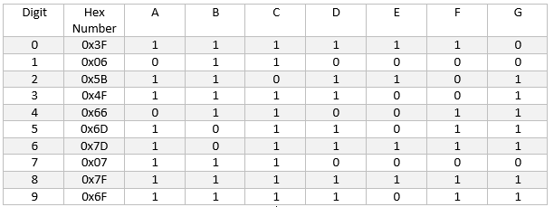
AT9S52 microcontroller & Interfacing seven segment display to 8051
Seven segment displays are used to indicate numerical information. Seven segments display can display digits from 0 to 9 and even we can display few characters like A, B, C, D, E, F, etc. These are very popular and have many more applications. I’ll show you how a 7 Segment Display works by interfacing 7 Segment Display to 8051 Microcontroller.

Slide 14
Programming AT89S52 Microcontroller
Atmel microcontroller can be programmed with different software's that is available in the market. Arduino, Keil uVision are the most used platforms to name a few.
In order to program the Atmel microcontroller we will need an IDE (Integrated Development Environment), where the programming takes place. A compiler, where our program gets converted into MCU(microcontroller unit) readable form called HEX files. An IPE (Integrated Programming Environment), which is used to dump our hex file into our MCUs.

Slide 15
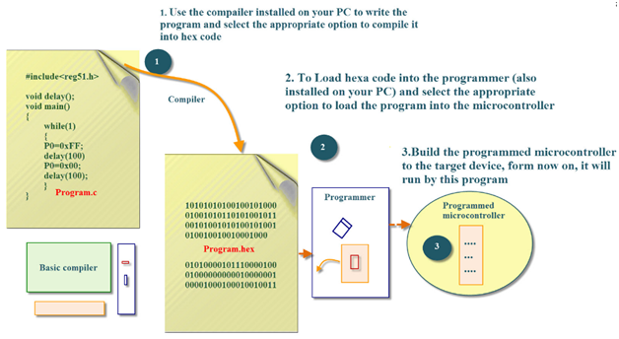
Block diagram representation of embedded system programming

Slide 16
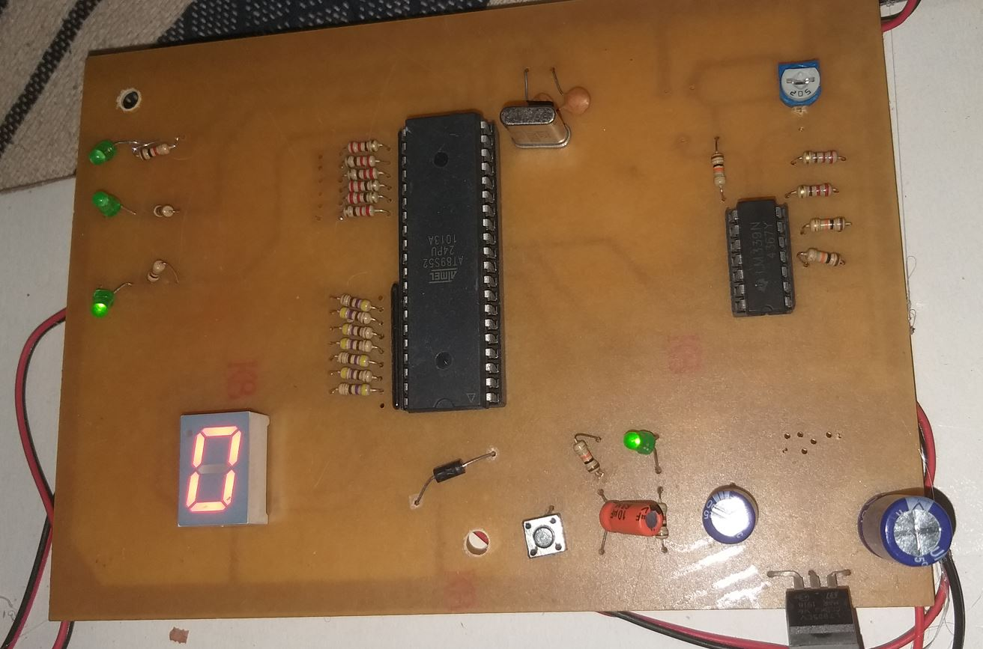
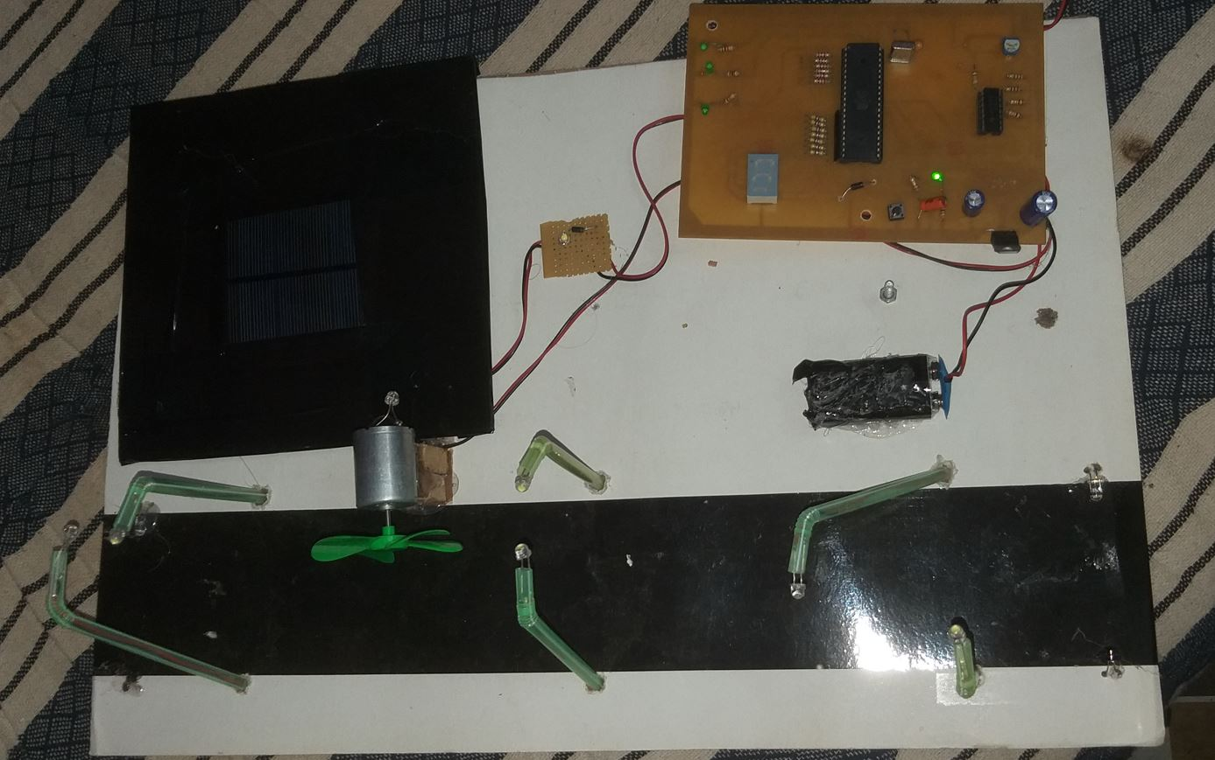
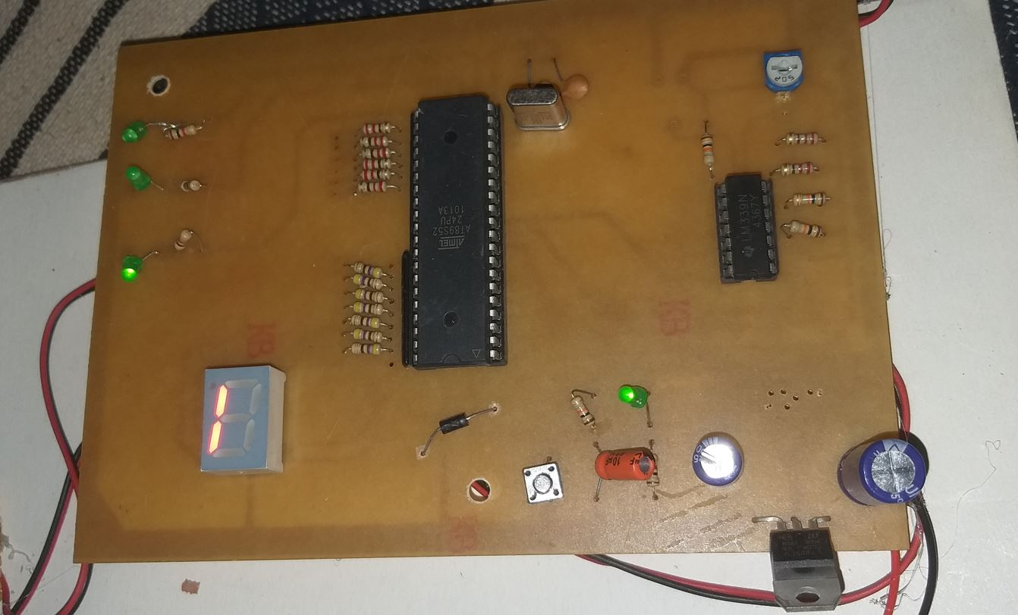
Project pics
When 1 vehicle in , 1will be display

Slide 17
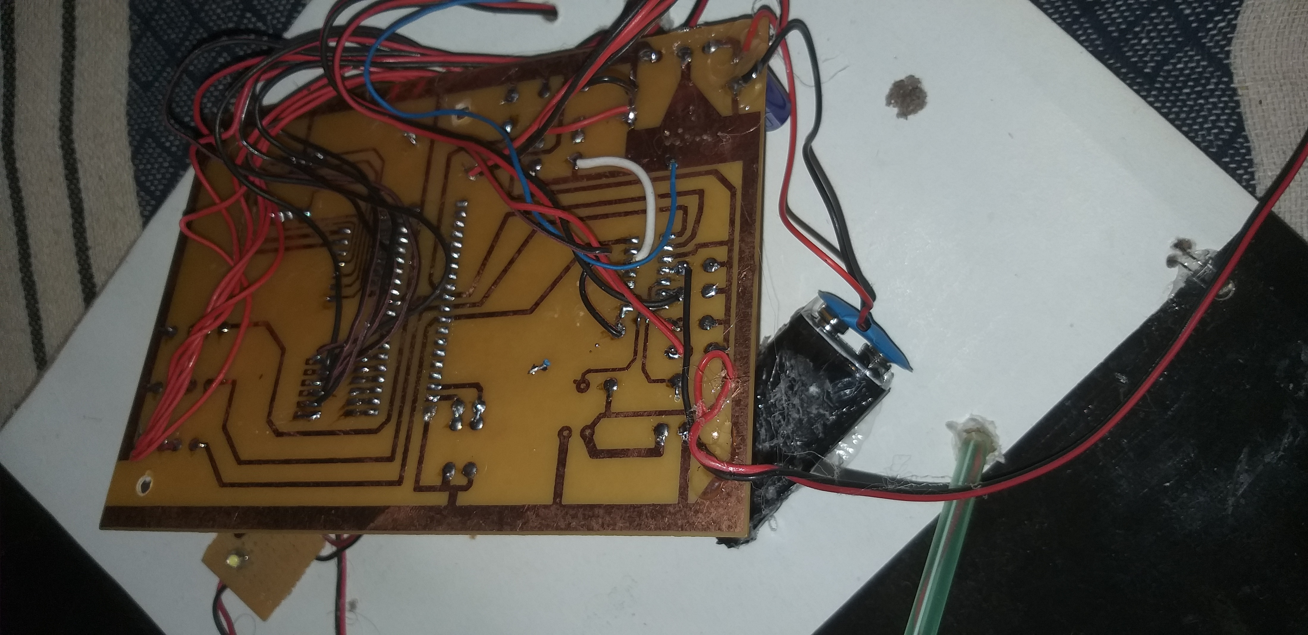
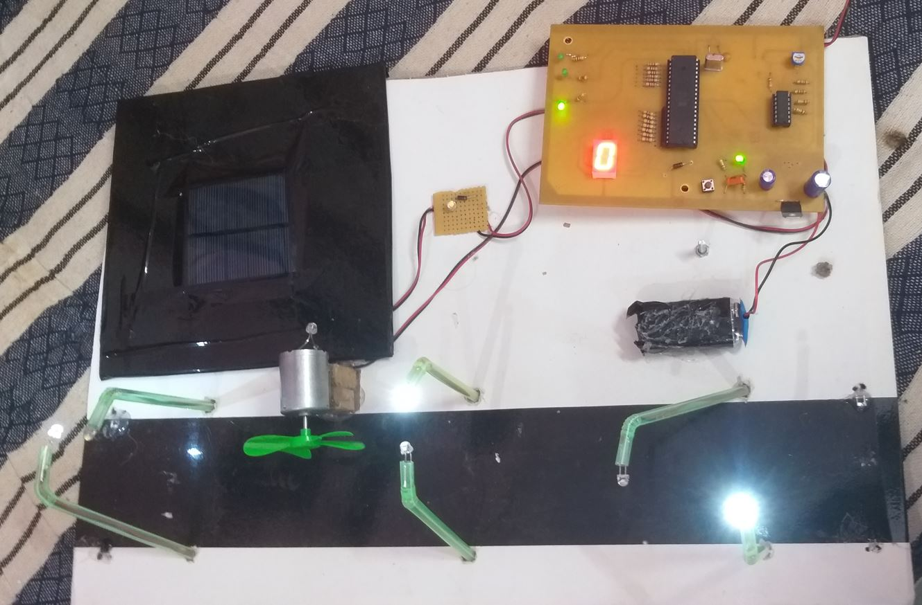
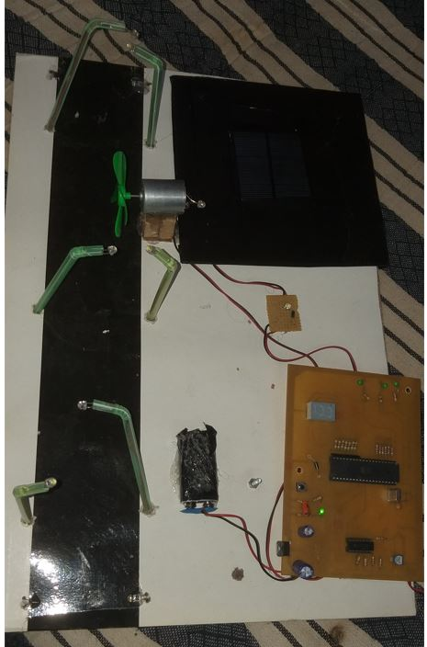
When no vehicle, 0 will be display
Circuit OFF

Slide 18
1.Keil µVision IDE
2.MC Programming Language: Embedded C
3.C language
SOFTWARE AND PROGRAMMING LANGUAGE

Slide 19
References
https://www.javatpoint.com/embedded-system-7-segment-display
https://www.javatpoint.com/embedded-system-8051-microcontroller
https://www.javatpoint.com/embedded-system-7-segment-display
https://embetronicx.com/tutorials/microcontrollers/8051/ir-sensor-interfacing-with-8051/
https://www.elprocus.com/infrared-ir-sensor-circuit-and-working/
https://www2.keil.com/mdk5/uvision/
https://www.javatpoint.com/embedded-system-c-programming
https://en.wikipedia.org/wiki/Embedded_C
https://www.irena.org/wind#:~:text=Wind%20power%20is%20one%20of%20the%20fastest%2Dgrowing%20renewable%20energy%20technologies.&text=Wind%20is%20used%20to%20produce,or%20wind%20energy%20conversion%20systems.

Slide 20
THANK YOU

